Slide 1
COPGEMINI CHALLENGE-1(AWS)
JANVI Ajudiya(18it003@charusat.edu.in)

Slide 2
BRIEF SYNOPSIS
As organizations grow in size, so does need for having better document processing.
This is all about building end-to-end intelligent document processing solution using AWS.
In this, we use various AWS services like Amazon S3 for storage, Amazon Textract for extracting text from scanned documents, Amazon Comprehend for training a model, Amazon Lambda for invoking function events, Amazon Cloudwatch to keep track of log of metrics, Amazon A2I for reviewing ML predictions and verification by humans, Amazon Cognito for creating and managing user pool along with sending notification and Amazon Sagemaker GroundTruth for A2I and for creating private team workforces.

Slide 3
PROBLEM STATEMENT
Building an end-to-end intelligent document processing solution using AWS.

Slide 4
TECHNOLOGY/TOOL/STACK
Technology : Amazon Web Services(AWS)
Services :
Amazon S3
Amazon Textract
Amazon Comprehend
Amazon Sagemaker
Amazon A2I(Augmented AI)
Amazon Lambda
Amazon Cloudwatch
AWS CloudFormation
AWS IAM

Slide 5
prerequisites
AWS account with necessary AWS IAM permissions to launch AWS CloudFormation Template.
AWS Free Tier is preferable.

Slide 6
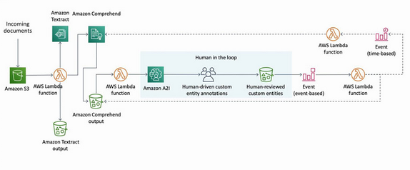
SOLUTION ARCHITECTURE
Workflow :

Slide 7
Continue…
In real-time solutions, I have made use of following services :
1. Amazon S3
2. Amazon Comprehend
3. AWS Identity and Access Management(IAM)(I have used roles and policies)
4. Amazon Sagemaker
5. Amazon Augmented AI
6. AWS CloudFormation

Slide 8
CONTINUE…
This solution takes images(scanned documents or screenshots or pictures of documents) as input.
Upload it to Amazon S3, this action will trigger AWS Lambda function.
Through notification event, function sends image to Amazon Textract to extract text from image.
It’s result will be send to Amazon Comprehend entity recognizer.
Amazon A2I starts human verification.
Now, Amazon A2I send an Amazon Cloudwatch event which will trigger lambda function and function checks for human reviewers.

Slide 9
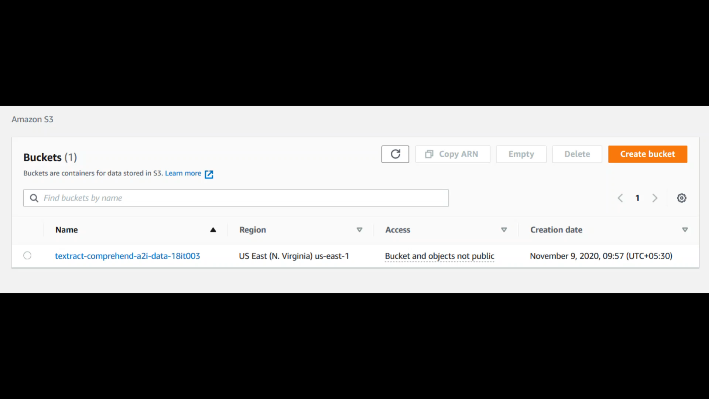
DEMO VIDEO of SCREENSHOTS

Slide 10
CHALLENGES FACED
Biggest challenge I faced was that when I tried to create private team from labeling workforces of Amazon Sagemaker after deleting once, it has deleted Amazon Cognito user pool also and due to that, I was unable to create private team again. When I tried by creating user pool again, then also it was showing error like ResourceNotFoundException: User pool ** <id> does not exist
Second biggest challenge I faced was that, in CloudFormation stack, during its creation, inspite of having all entities correct, it gets back to ROLLBACK_COMPLETE stage and hance, CREATION_COMPLETE stage was not displayed. Due to that, analysis job of Amazon comprehend was showing status failed.
Third small challenge I faced was that, “We are unable to create/update the role or policy in train custom entity recognizer of comprehend”.
But I tried different solutions 4 times and at the end, I was able to complete this challenge.

Slide 11
FUTURE ENHANCEMENTS
We can further expand this challenge.
We can create all this stuff in VPC and buckets objects are kept private.
We can attach one policy to each IAM role to specify that particular task only.
Also, we can use notebook instance of Amazon Sagemaker as well as we can attach AWS KMS service for more security along with request to Sagemaker API for SSL certificate.
We can encrypt our data at rest as well as in transit mode.
We can also use Amazon GuardDuty for threat detection and AWS Shield for protection against DDoS attacks by configuring application load balancer.
So, ultimately next level will be security although it is secure but we can make it more secure and it is best practice.

Slide 12
THANK YOU…

